Slide 1

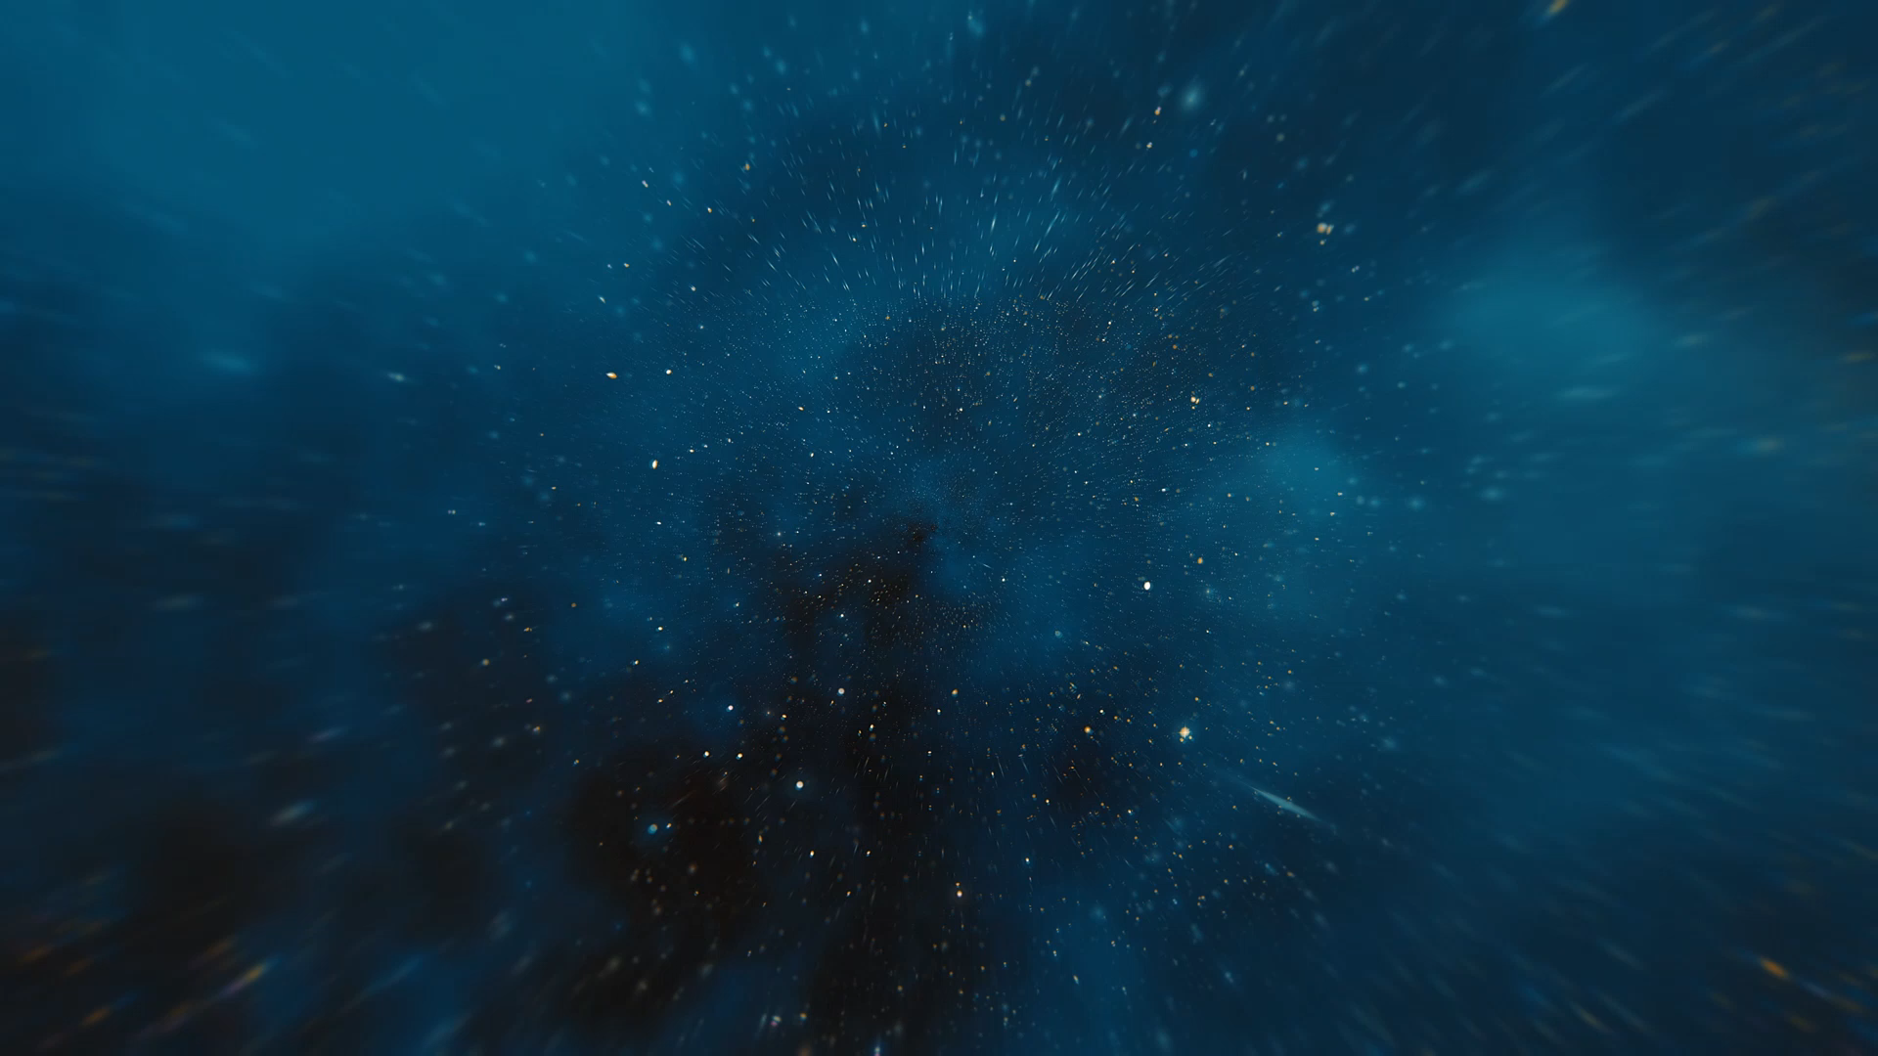

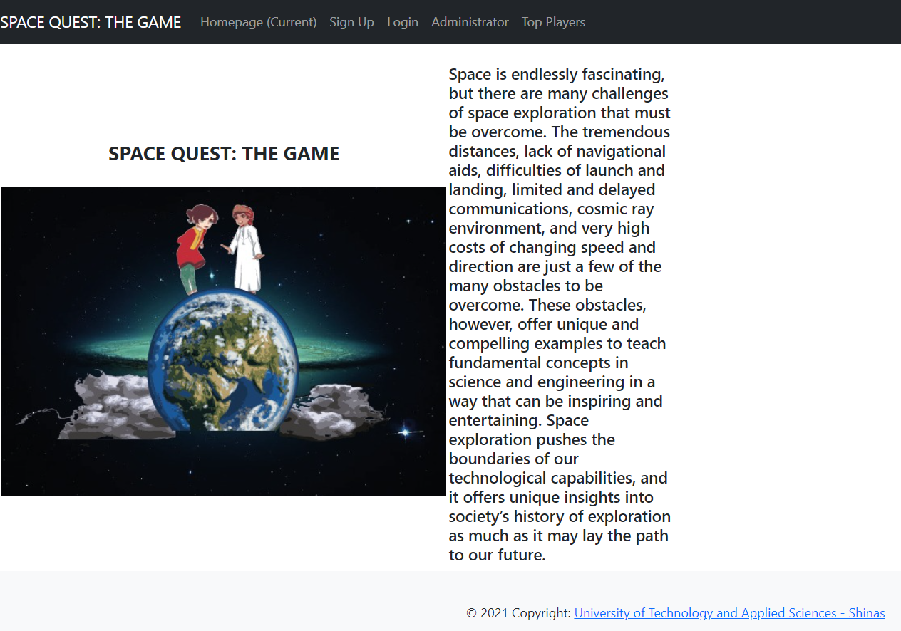
Space Quest: The Game
TEAM APEX
Khalil Ibrahim Hussein AlBalushi
Yousuf Fadhil Salim AL-Mamari
Mohammed Ali Rashid Al-Moqbali
Arwa Yahya Khalfan AlMaqbali
Hadil Darwish Talib AlHosni
Noor Alhuda Mohammed AbdallahAl-Shezawi

Slide 2



Challenge and Our Solution
CHALLENGE:
to create a game that teaches players about space from the perspective of the architectures and challenges of exploration. The setting can be anything, from the past, to the future, with destinations either in our solar system, or beyond.
OUR SOLUTION:
to provide a web-based game application that allows players to register and play. The game provides players opportunities to learn about space exploration through “Question and Answer approach”. This web-based game allows players to reach Level 5 which is being Space Quest Expert Explorer by scoring points in various questions from various missions.
GAINS:
Leads to the design and development of Computer-Aided Instruction (CAI) that can teach people the complexities of space flights and explorations.
Educate people about our planet, our universe, and space discoveries. Encourage and motivate them to read and explore more about space missions.
OPPORTUNITIES:
Offer a venue of learning and education about space exploration.
Provide easy method of explaining complex ideas through “Q and A approach”.

Slide 3
Our Solution in details
Two users: Player – who plays the game, and Administrator – who manages the missions and its questions in the form of fill-in-the-blank, true or false, and multiple choice questions.
Allow players to sign-up/register and login upon registration.
In the user main page, the player can choose the different missions based on his/her current level.
Upon selecting a mission, the player can choose what type of questions (fill-in-the-blank, true or false, multiple choice), then the player must answer that question. If the player will get the correct answer, then the player receives the assigned point, and it will be added to the player’s score.
If the player’s score is from 0 to 100, the level is 1 which is Space Quest Newbie Discoverer. While if the score is from 101 to 200, then the level is 2 which is Space Quest Novice Explorer. Then, to reach Level 3 – Space Quest Advanced Explorer, 300 points is needed, level 4 – Space Quest Proficient Explorer, 400 points is needed, and Level 5 – Space Quest Expert Explorer, 500 points is needed.
The administrator can add, update, delete, and view lists of missions, and the different types of questions.
In the main page, it displays also the TOP 5 players.

Slide 4
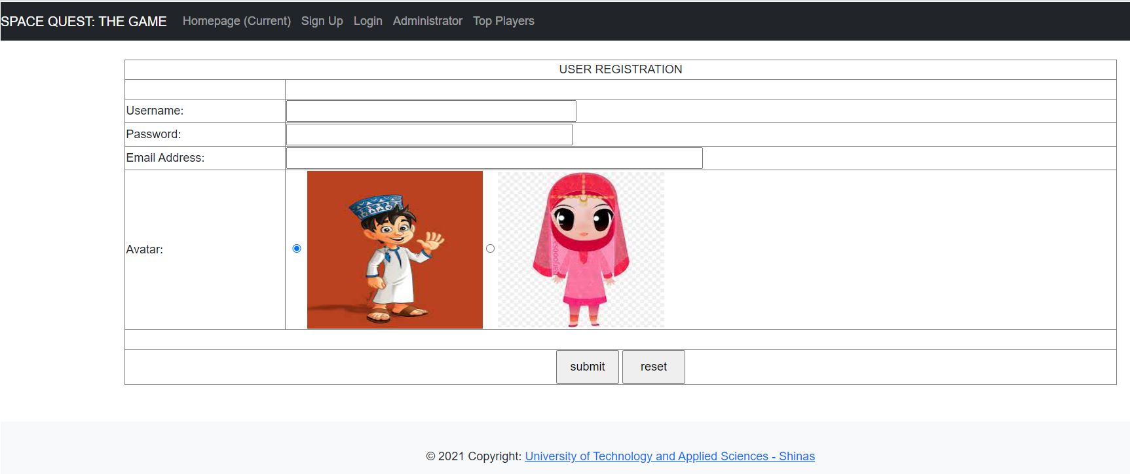
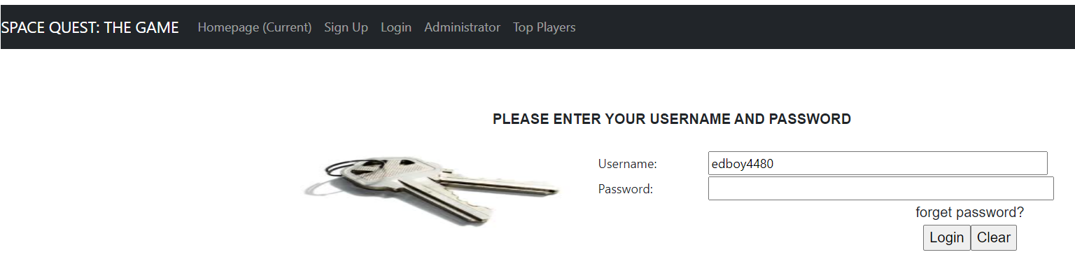
Homepage
Sign-up Page
Login Page
Sample screenshots of the designed and developed webpage

Slide 5
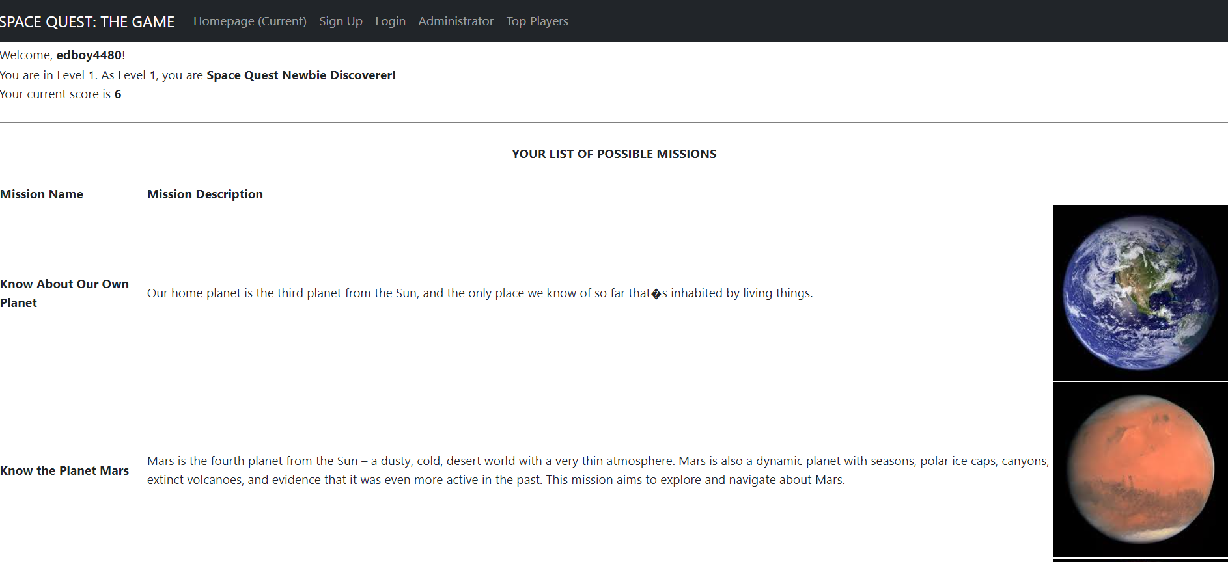
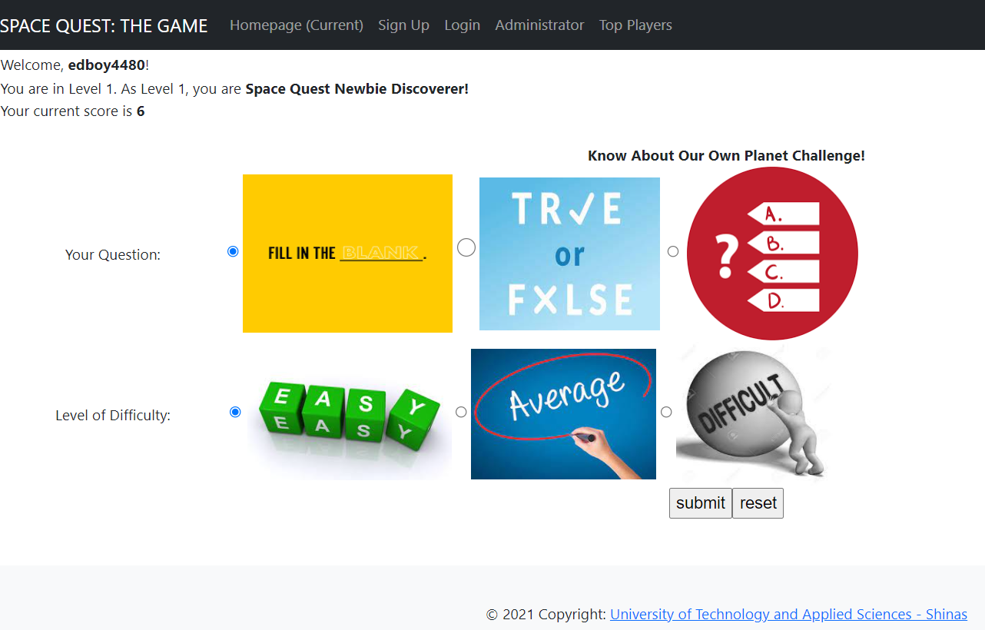
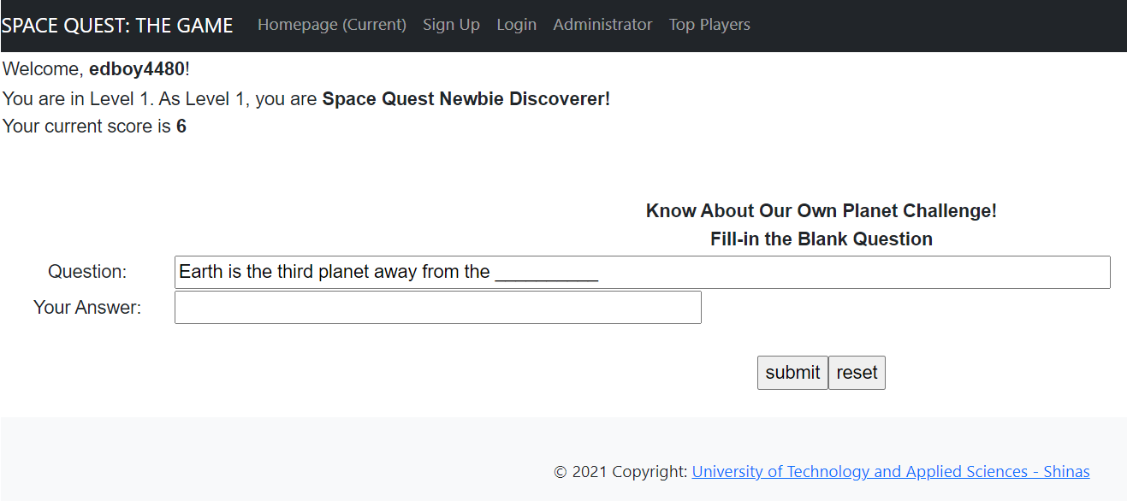
User main page
Mission Page
Question Page
Sample screenshots of the designed and developed webpage

Slide 6
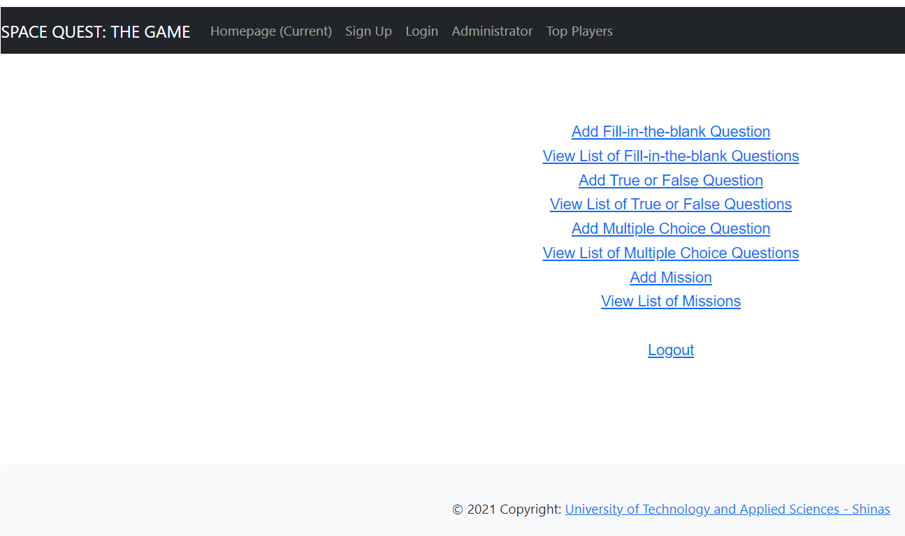
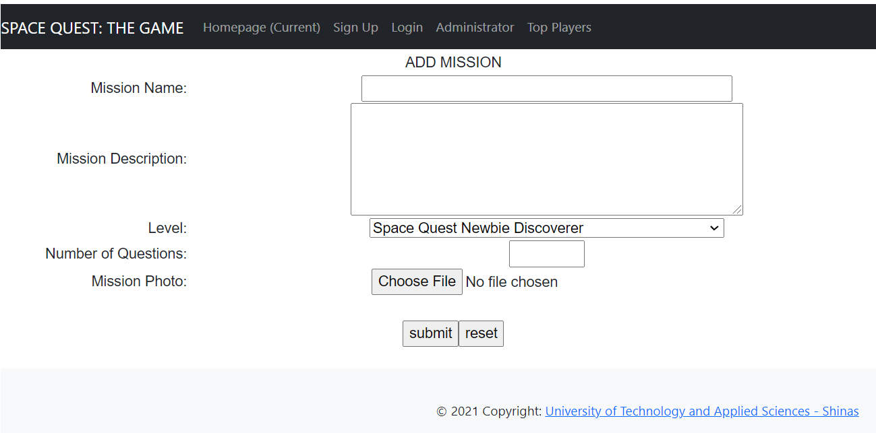
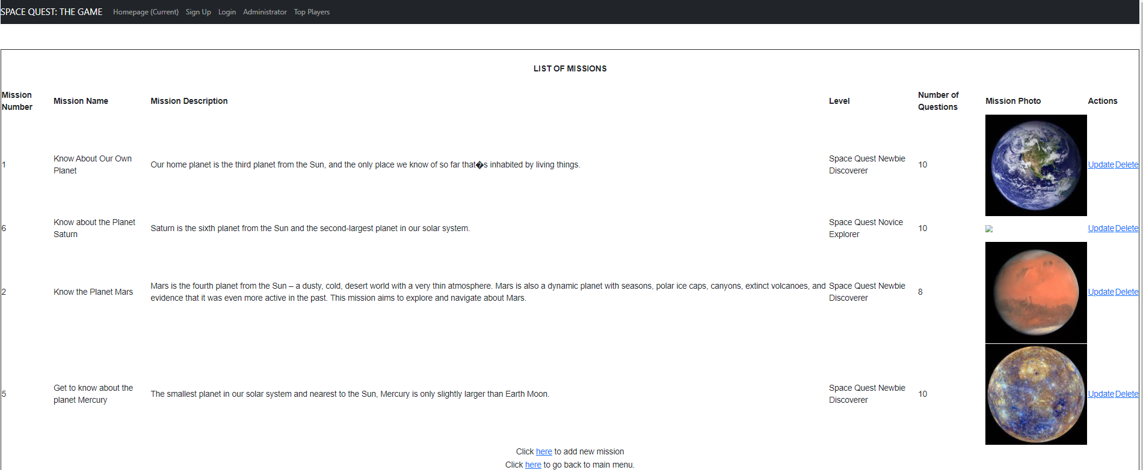
Admin main page
Add Mission Page
View Mission Page
Sample screenshots of the designed and developed webpage

Slide 7


Future Works
Integrate lessons on space flights and exploration.
Provide trivias on various topics/subject matters
Allow multi-player quiz bee setting
Improve the User Interface Design
Provide other forms of question such as matching type, cross-word puzzle, etc.
Integrate time limit in answering questions

